Slide 1
AI Cancer Detection Project Using CNN
COMPANY NAME: MAH | June 6, 2025
We (MAH) will be training an AI model to differentiate between healthy brains and one's with cancer through images of brain scans

Slide 2
Amanda Loeung
Hamza Harb
Melodie Cornelly
MAH
Our team

Slide 3
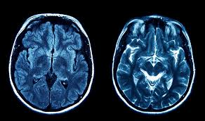
Team MAH wanted to aid medical professionals in detecting brain tumors from MRI scans using deep learning.
MAH
What did we explore & What research did we make?
We explored the use of CNNs for automated detection of abnormalities in MRI scans.

Slide 4
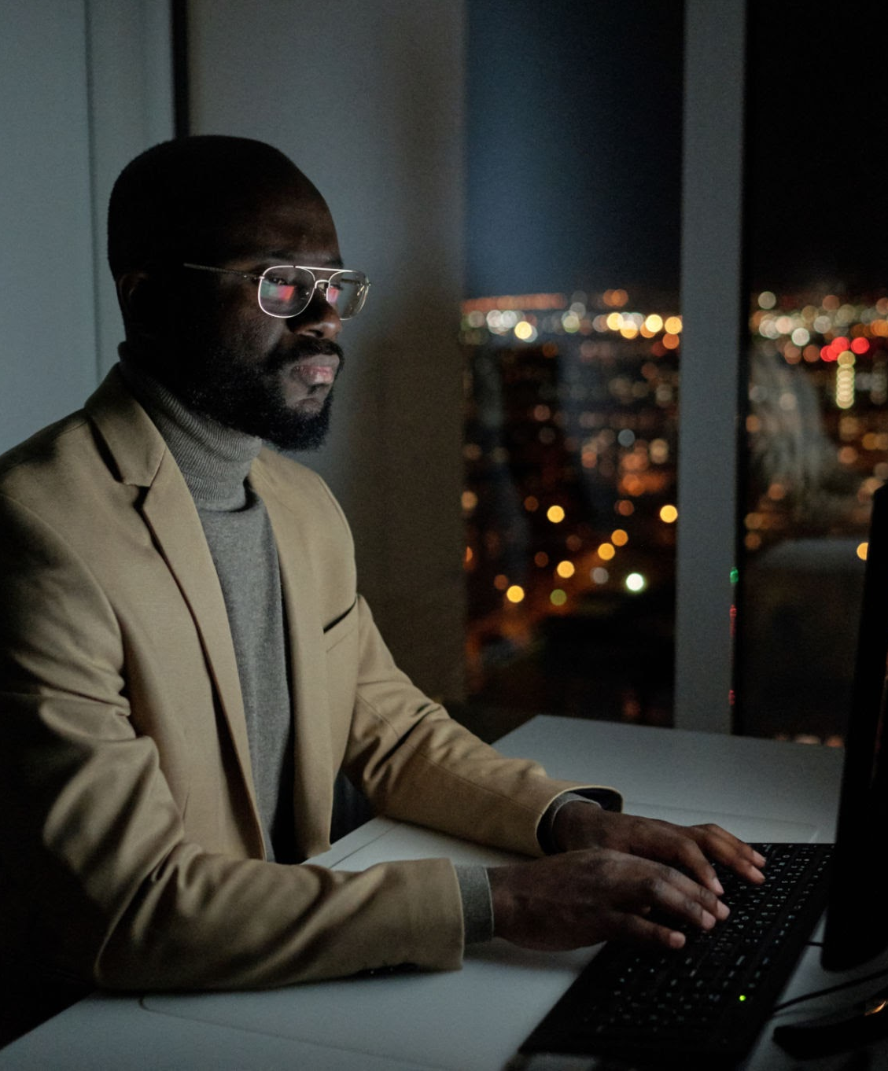
MAH
About the Dataset
URL: Brain Tumor Dataset: Segmentation & Classification
5712 images for training:
Pituitary: 1457 images
No Tumor: 1595 images
Meningioma: 1339 images
Glioma: 1321 images
1311 images for testing:
Pituitary: 300 images
No Tumor: 405 images
Meningioma: 306 images
Glioma: 300 images
Resized images to 224x224

Slide 5
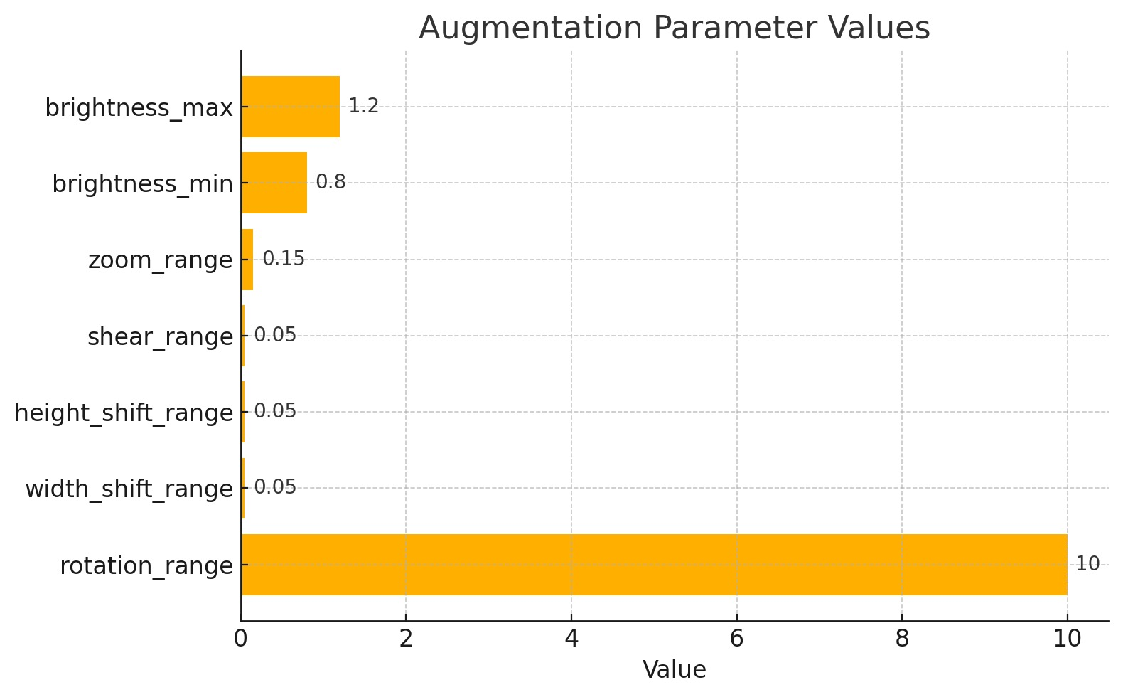
Experimentation

Slide 6
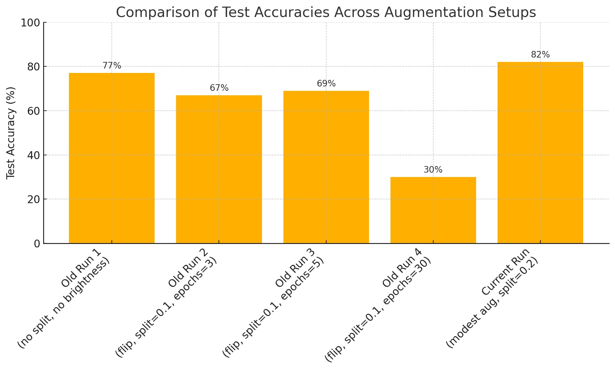

Slide 7
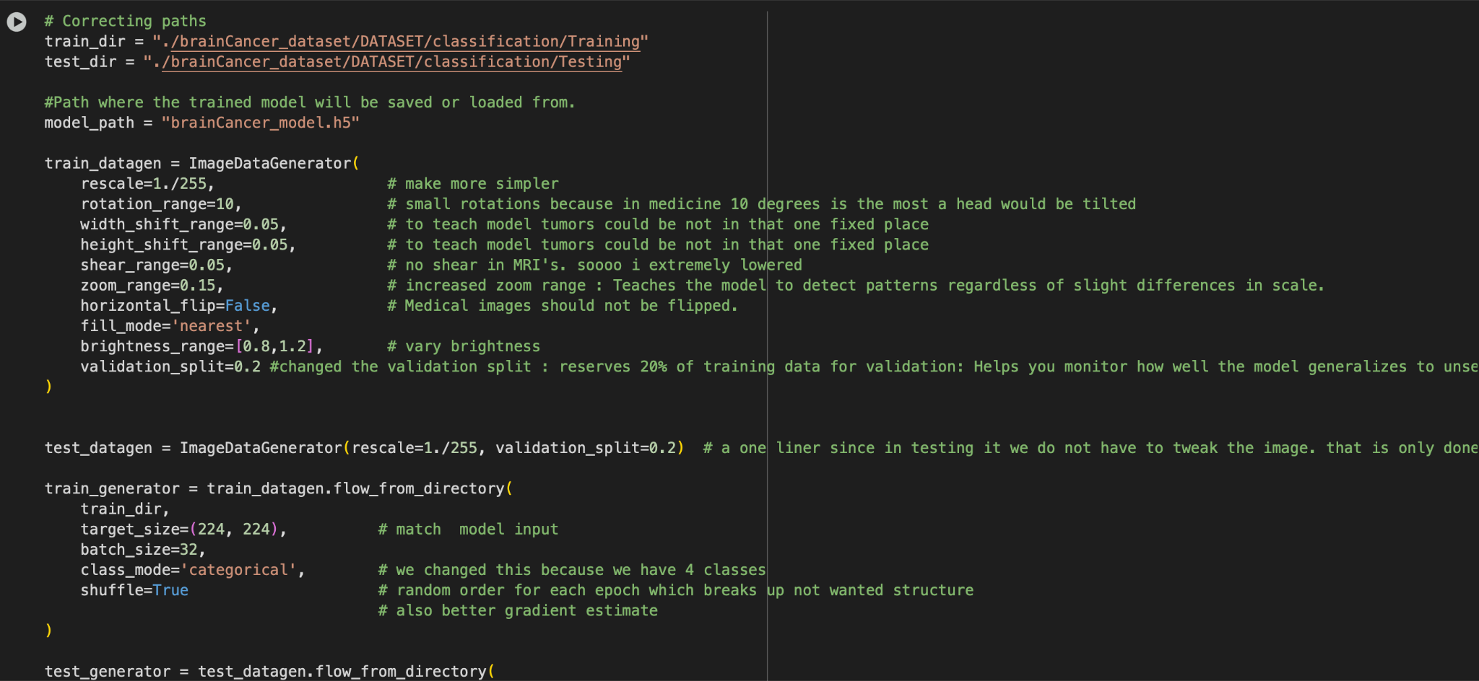

Slide 8
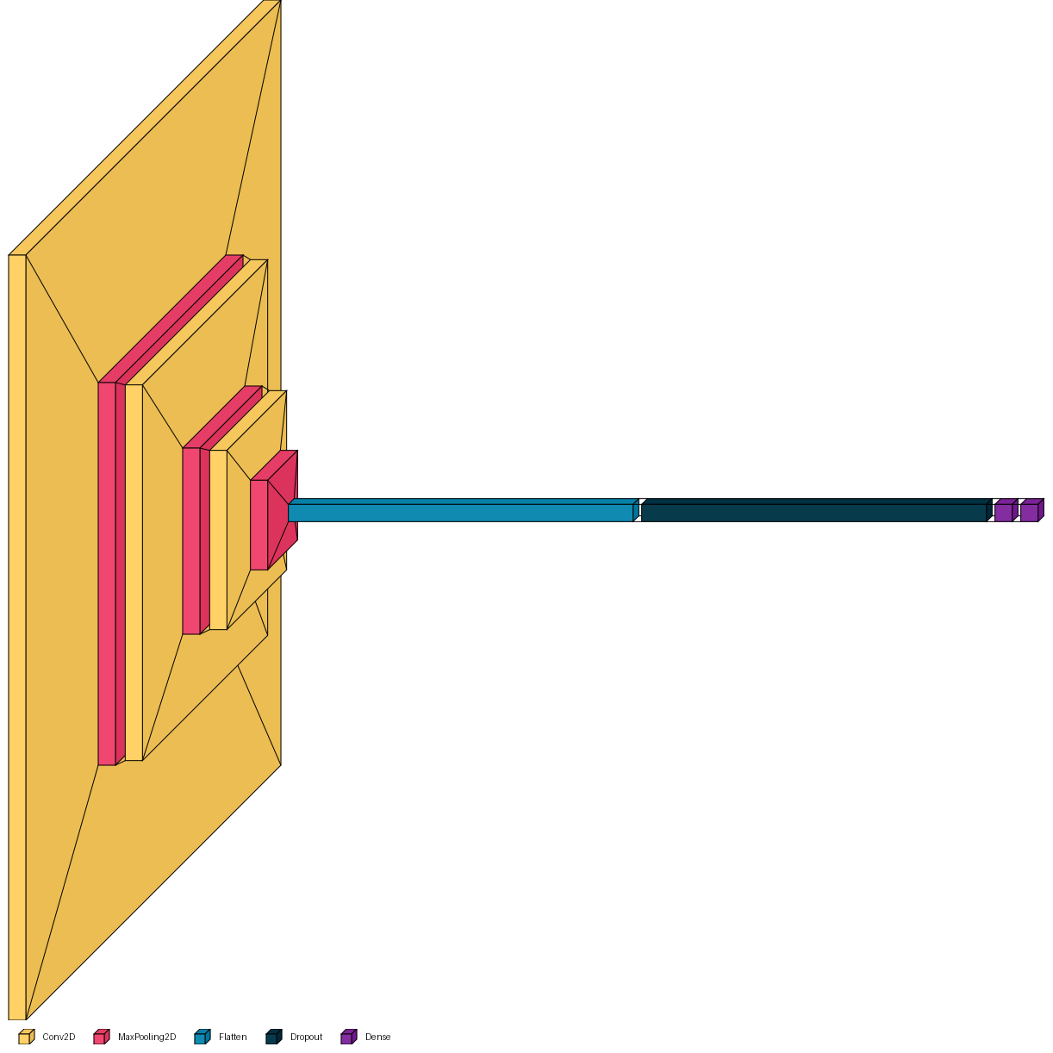
MAH
#first convolutional layer
model.add(Conv2D(32,(3,3), activation = 'relu', input_shape =(224,224,3)))
#MaxPooling to reduce spatial size
model.add(MaxPooling2D(pool_size=(2,2)))
#second convolutional layer
model.add(Conv2D(64,(3,3), activation = 'relu'))
#MaxPooling
model.add(MaxPooling2D(pool_size=(2,2)))
#third convolutional layer
model.add(Conv2D(128,(3,3),activation = 'relu'))
#MaxPooling
model.add(MaxPooling2D(pool_size = (2,2)))
#Flatten the 2D feature maps into 1D vector
model.add(Flatten())
#Dropout to reduce overfitting
model.add(Dropout(0.5))
# Fully Connected (Dense) layer
model.add(Dense(128, activation='relu'))
# Output layer: 4 neurons with softmax for categorical classification
model.add(Dense(4, activation='softmax'))

Slide 9
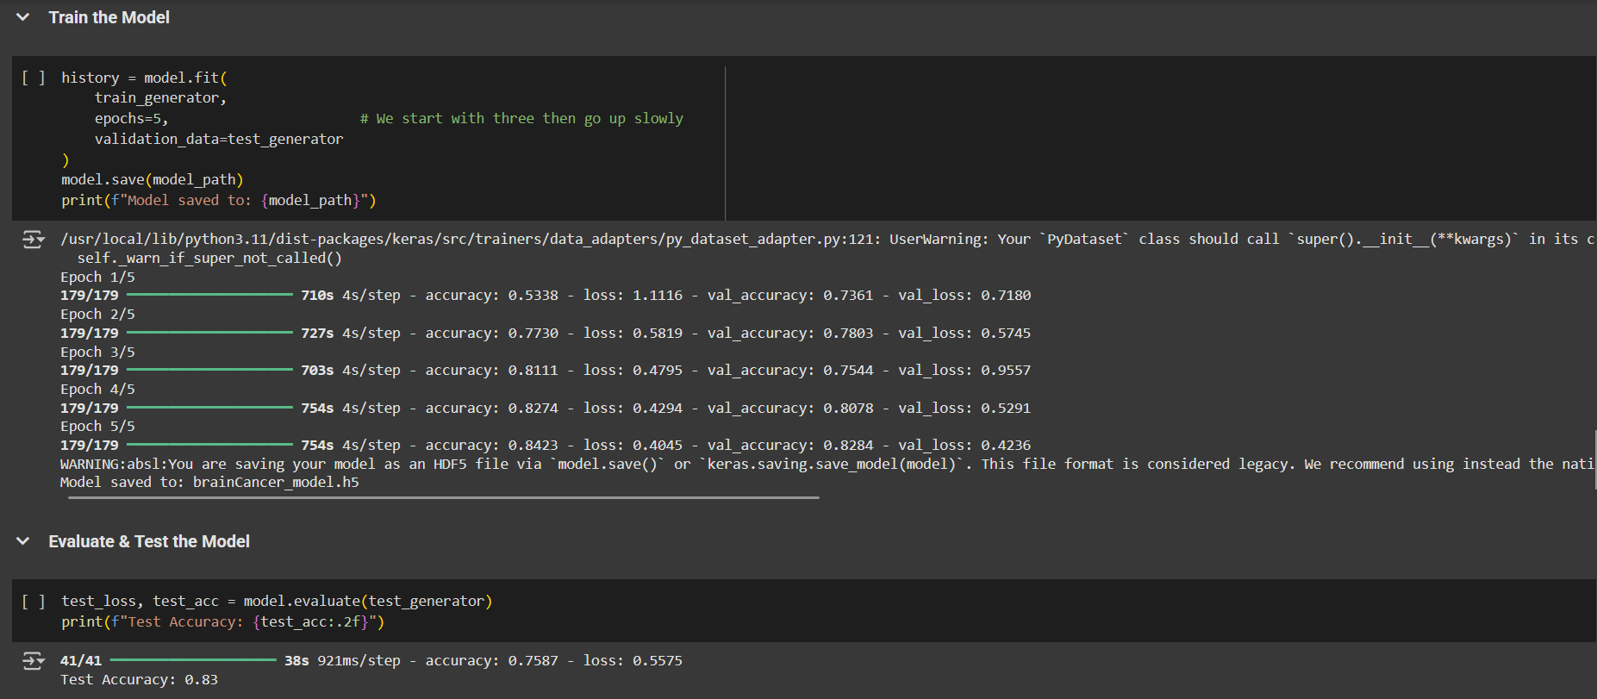
The dataset consists of labeled MRI brain images that we categorized into 4 classes. Glioma, Meningioma, Pituitary, No Tumor.
We prepared the MRI images by Rescaling, rotation, zoom, and brightness adjustment.
MAH

Slide 10
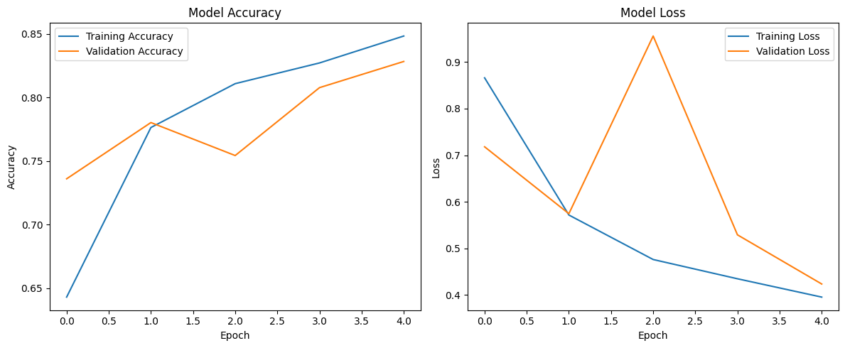
Graph of Model Training

Slide 11
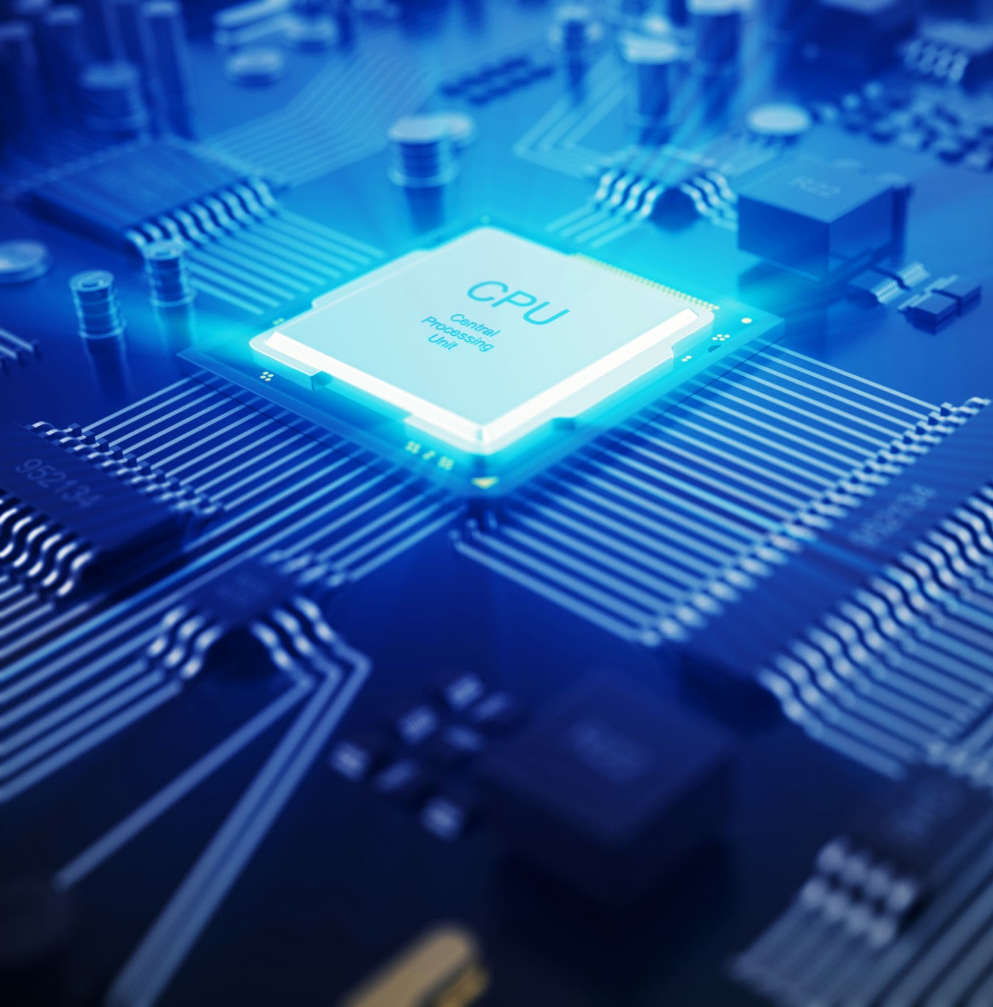
MAH
Final Model Performance
Metric | Value
Accuracy | 83%
Epochs | 5
Loss | 0.4236%
Layers | 10
The model showed steady improvement in accuracy over epochs and was able to classify the MRI images with 83% accuracy on the test set.

Slide 12

Demo: Brain Cancer Detection

Slide 13
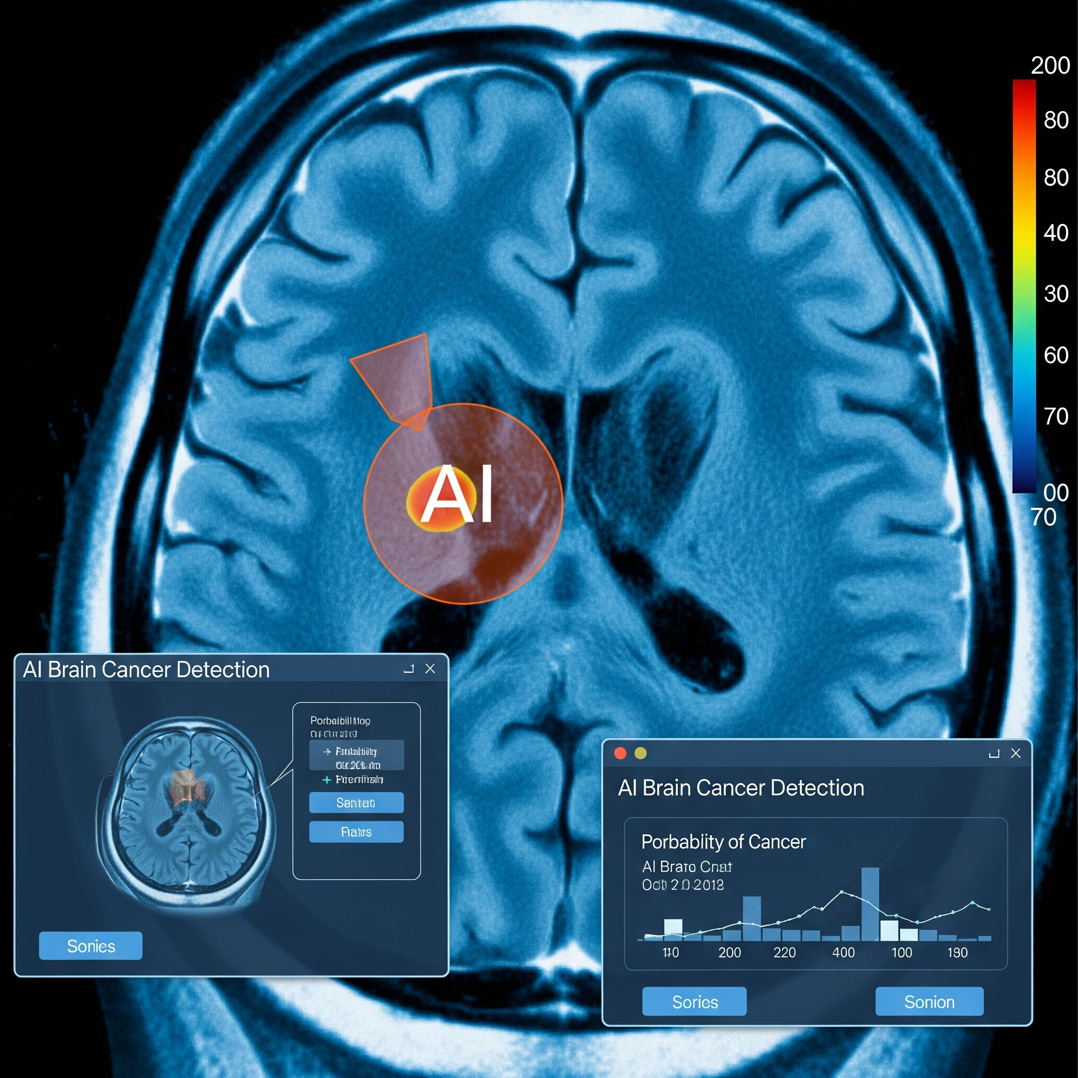
CMAH
LEARNING EXPERIENCE
What did our team learn
.
We learned how to train a CNN, work with MRI data, and improve accuracy using image preprocessing. It also helped us build real experience applying AI to a healthcare problem.
What was difficult
One of the challenges we faced during the project was deciding the optimal number of epochs and figuring out how to improve our data augmentation to boost model performance.
Overall is it ethical to rely on AI for medical diagnoses when mistakes could affect someone's health?
AI can support doctors by improving speed and accuracy, but it shouldn't replace human judgment especially in high-risk situations. Ethical use means AI should be a tool, not a decision-maker

Slide 14
Amanda Loeung
Hamza Harb
Melodie Cornelly
Thank you!
MAH

